Slide 1
Computer Systems Architecture

Slide 2
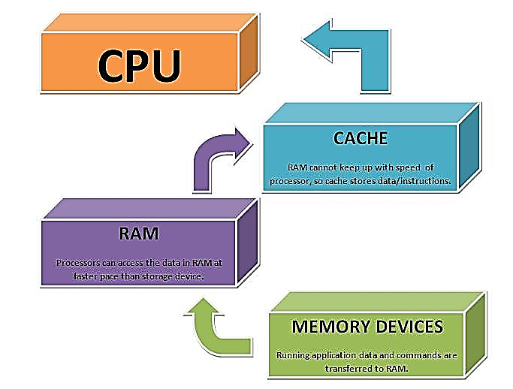
Cache Memory

Slide 3
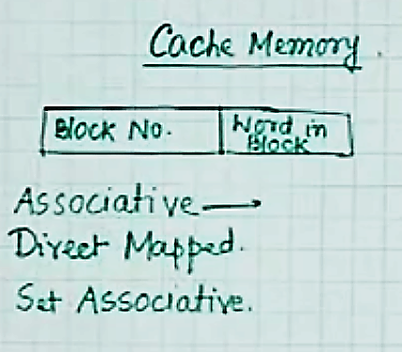
Cache Memory

Slide 4
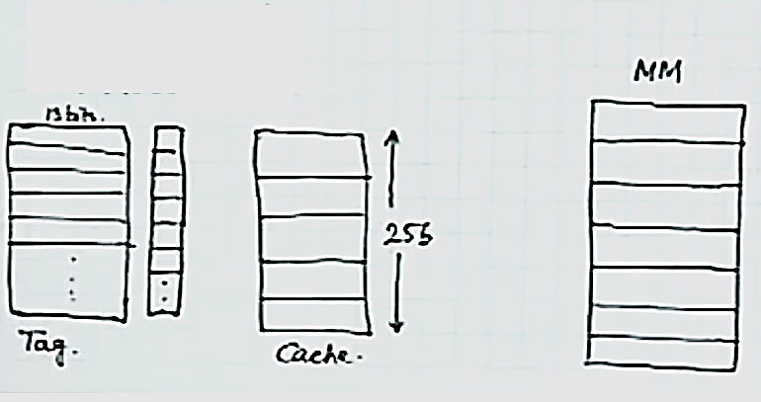
Associative Cache Mapping

Slide 5
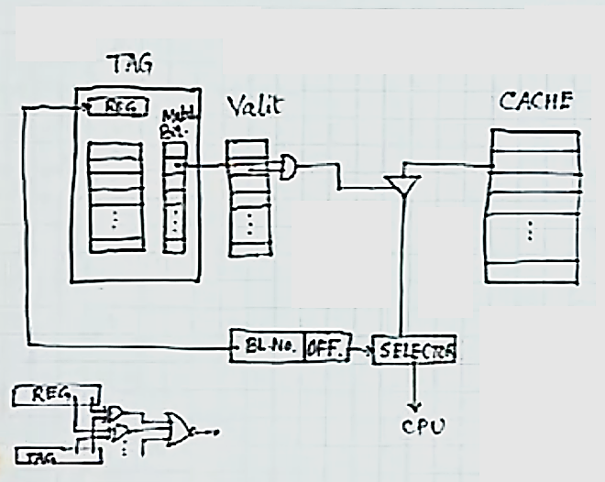
Associative Cache Internal HW

Slide 6
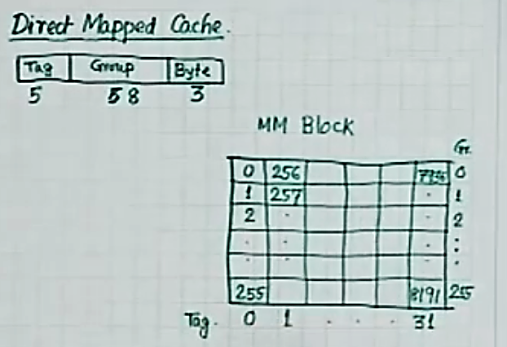
Direct Mapped Cache

Slide 7
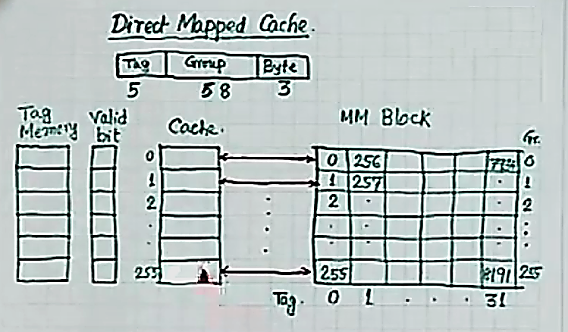
Direct Mapped Cache

Slide 8
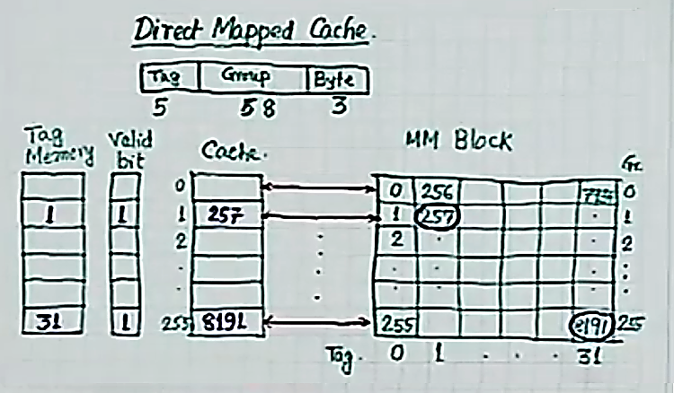
Direct Mapping Example

Slide 9
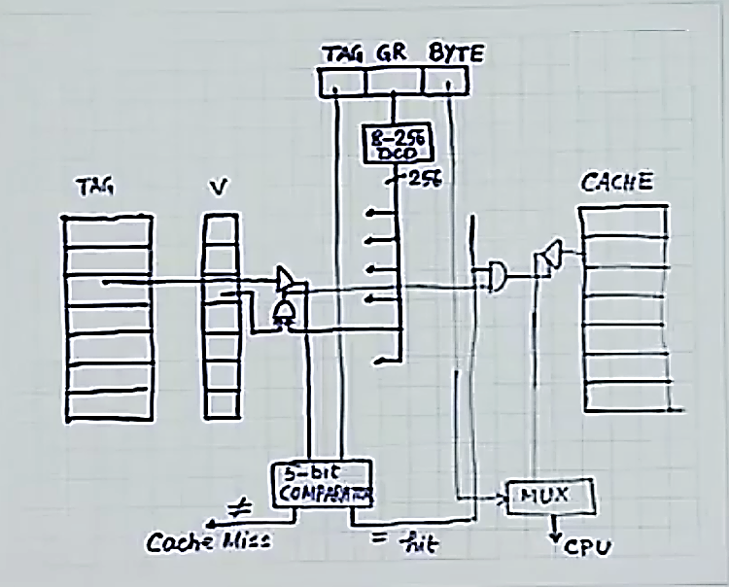
Direct Mapping Internal HW

Slide 10
Direct Mapping Internal HW

Slide 11
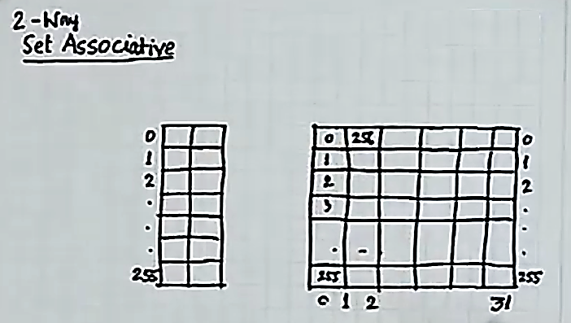
Set Associative Cache

